Slide 1
ADAPTIVE IMMUNITY
Michael Frimpong
Department of Molecular Medicine

Slide 2
Learning Objectives
To describe general characteristics of the specific immune response
To describe the molecular events involved in class switching and membrane immunoglobulin expression
To compare and contrast antigens recognized by the TCR and BCR.
To describe the pathways involved in processing endogenous and exogenous antigens.
To describe the major antigen presenting cells.

Slide 3
Characteristics of the Adaptive Immune Response
Self / non-self discrimination
One characteristic feature of the specific immune system is that it normally distinguishes between self and non-self and only reacts against non-self.
Memory
The immune system "remembers" if it has seen an antigen before and it reacts to secondary exposures to an antigen in a manner different than after a primary exposure.
Only an exposure to the same antigen will illicit this memory.
Specificity
High degree of specificity in its reactions.
response to a particular antigen is specific for that antigen

Slide 4
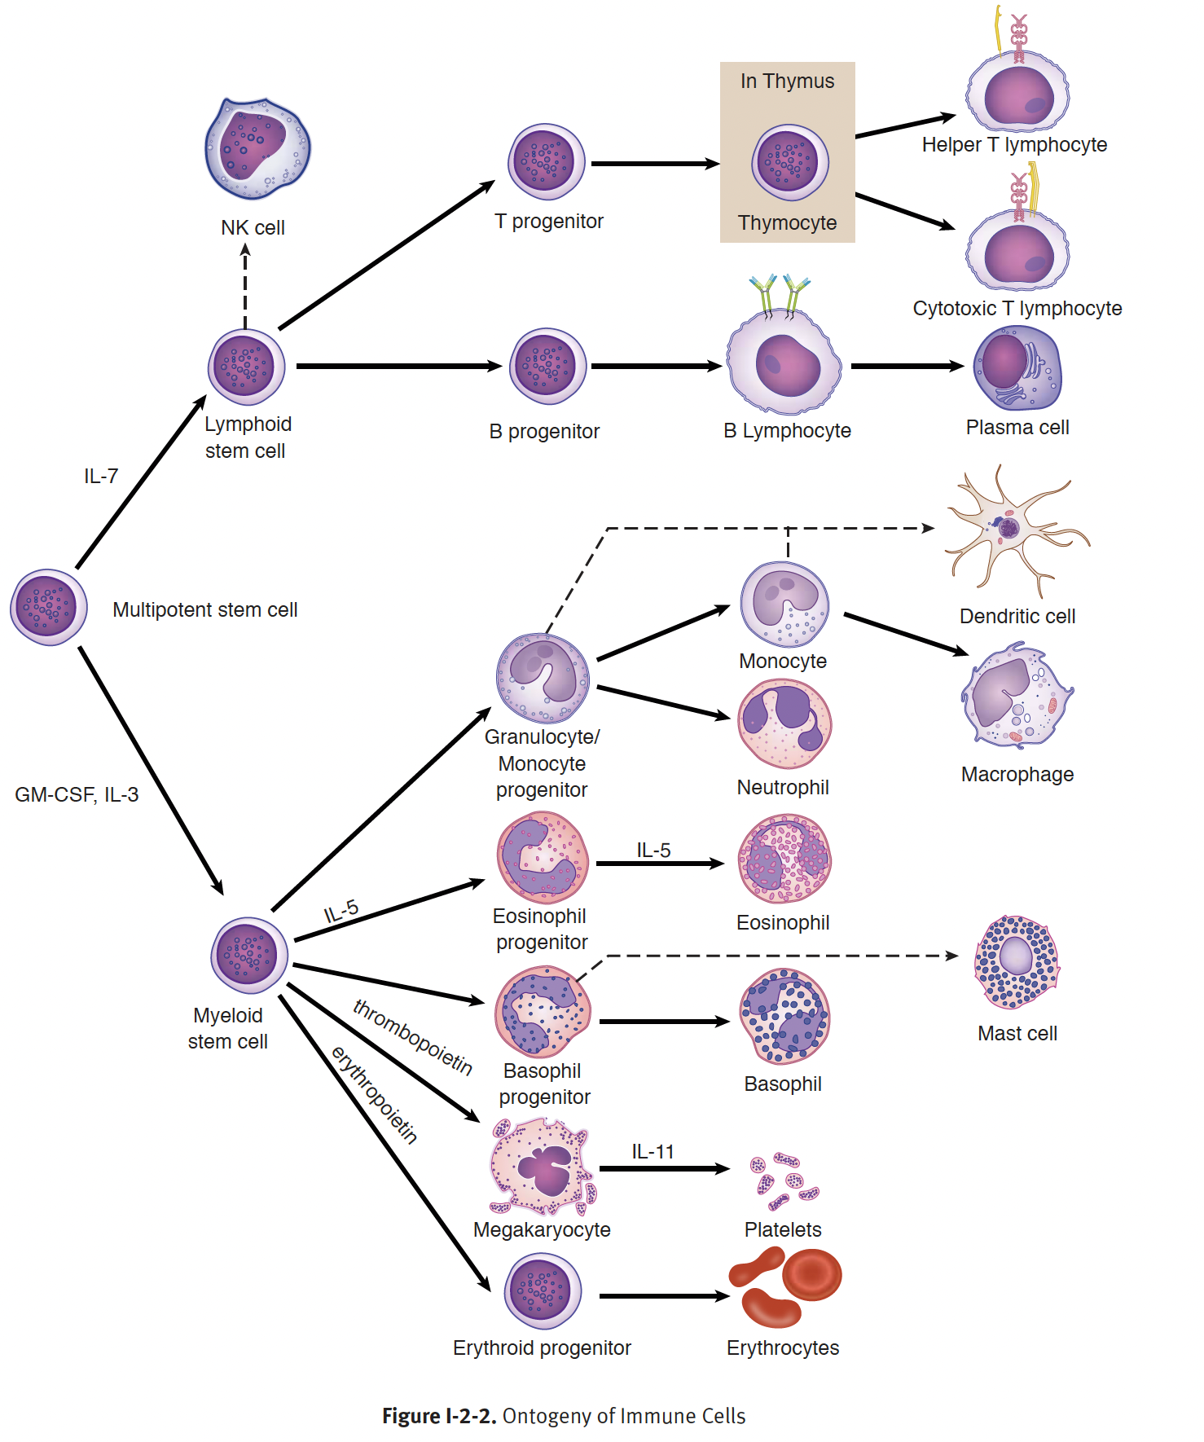
Origin of cells of the immune system

Slide 5
Cellular Components of the Adaptive Immune system
Cells of the myeloid lineage, except erythrocytes or megakaryocytes, perform non-specific, stereotypic responses and are members of the innate immune response
B and T lymphocytes of the lymphoid lineage perform focused, antigen-specific roles in immunity
Natural killer cells also from the lymphoid lineage, participate in innate immunity

Slide 6
Lymphocytes
B and T lymphocytes in the bloodstream are almost morphologically indistinguishable at the light microscopic level, but represent 2 interdependent cell lineages
B lymphocytes remain in the bone marrow to complete their development
T lymphocytes leave the bone marrow and undergo development in the thymus
Both B and T lymphocytes have surface membrane receptors to bind specific antigens

Slide 7
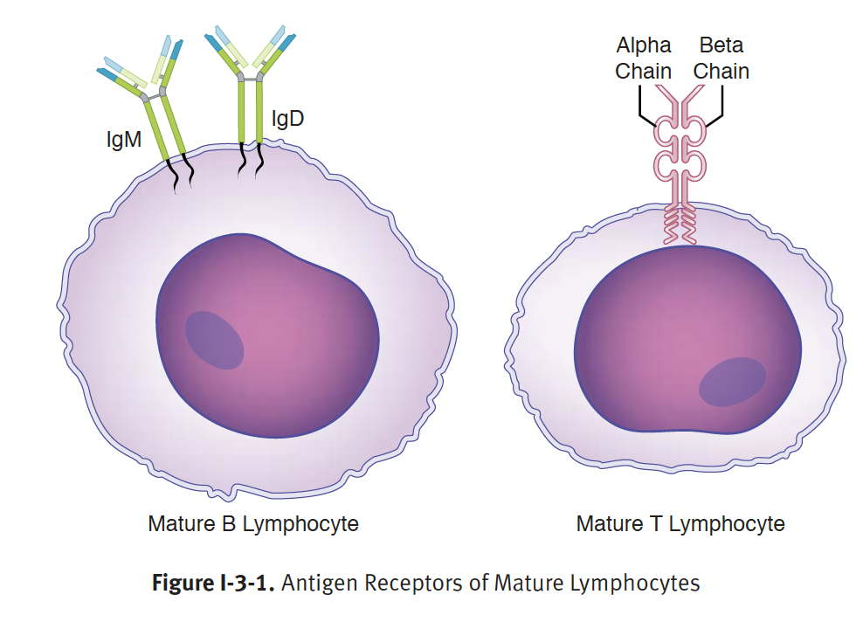
Antigen recognition Molecules of lymphocytes
Each cell of the lymphoid lineage is clinically identified by the characteristic surface molecules that it possesses
The matured, naive B lymphocyte, in it
matured ready-to-respond form, expresses
2 isotypes of antibody or immunoglobulin
called IgM and IgD within its surface membrane
The matured, naive T cell expresses
a single genetically related molecule,
called T-cell receptor (TCR) on its surface
Notes:
- Both of these types of antigen receptors are encoded within the immunoglobulin superfamily of genes and are expressed in literally millions of variations in different lymphocytes as a results of a complex and random rearrangement of cells’ DNA.

Slide 8
Selection of T and B lymphocytes
Lymphoid progenitors develop in the bone marrow, they make rearrangements of their germline DNA to produce unique idiotypes of antigen recognition molecules
Bone marrow is a primary lymphoid organ because it supports and encourages these early developmental changes
B lymphocytes complete their entire formative period in the bone marrow and can be identified by the immunoglobulin chains they produce

Slide 9
B Lymphocyte development
Gene segment rearrangements occur randomly and in the absence of stimulation with foreign antigen
Cells whose idiotype has too great an affinity for normal cellular molecules are either deleted in the bone marrow (clonal deletion) or inactivated in the periphery (clonal anergy)
Anergic B cells express high level of IgD on their surface rendering them inactive
Only cells that are selectively unresponsive (tolerant) to self-antigens are allowed to leave the bone marrow

Slide 10
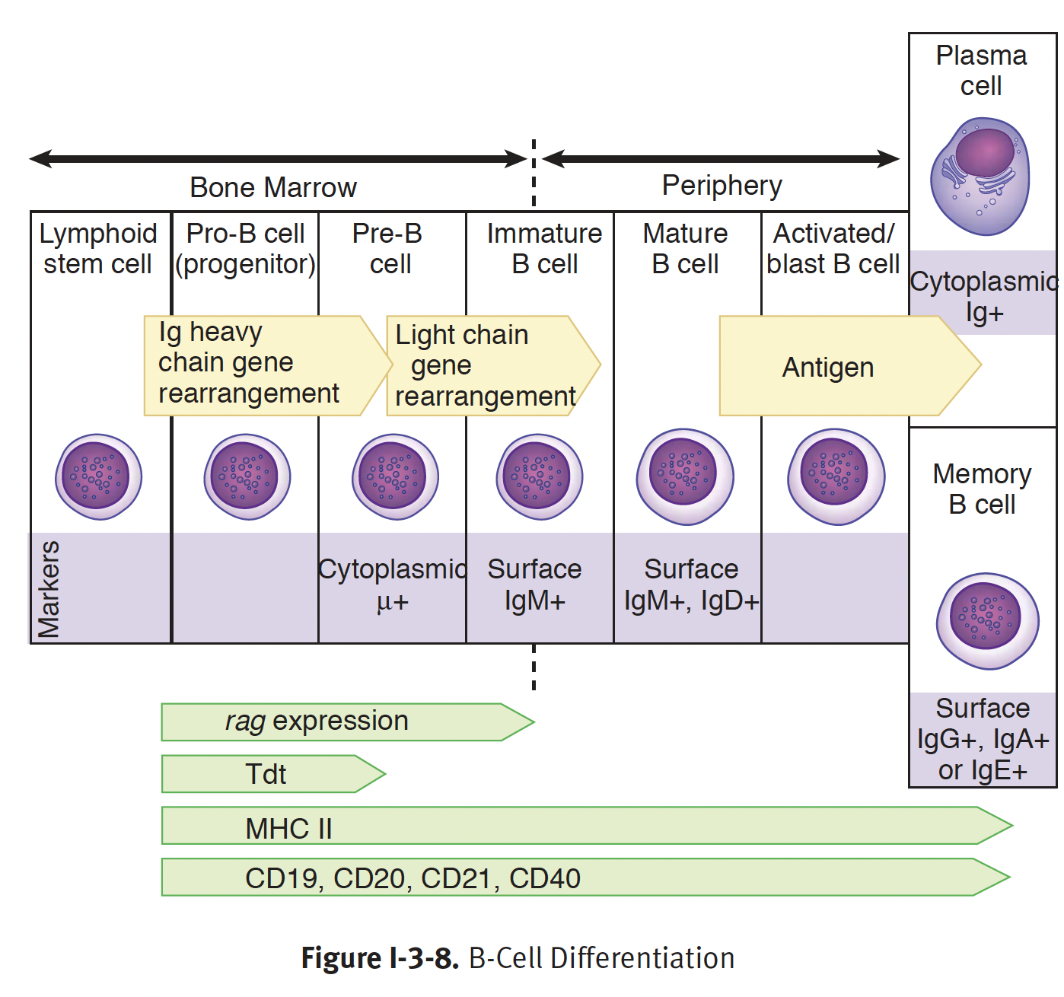

Slide 11
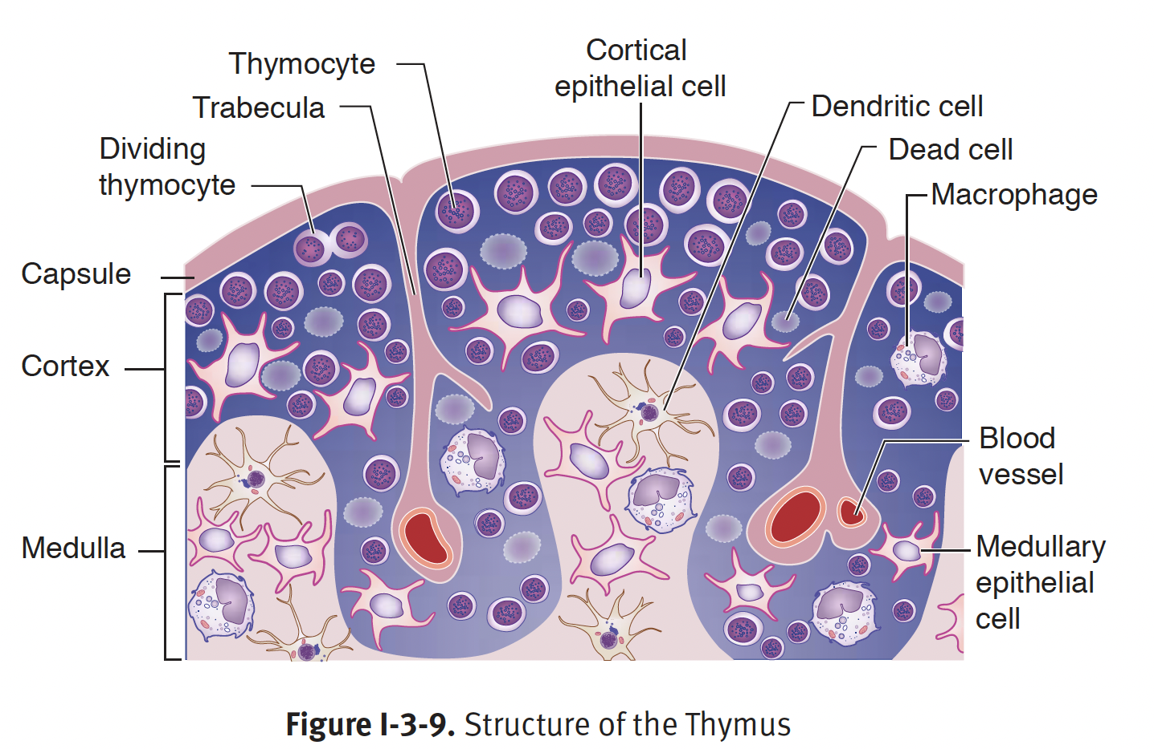
T Lymphocyte development
Immature lymphocytes destined for T-cell lineage leave the bone marrow and proceed to the thymus, the second primary lymphoid organ dedicated to T-cell maturation
These pre-thymic cells are referred to as double-negative T lymphocytes since they do not express CD4 or CD8 on their surface
Notes:
- The thymus is a bilobed structure located above the heart; it has an outer cortex packed with immature T cells and an inner medulla into which cells pass as they mature
Both the cortex and the medulla are laced with a network of epithelial cells, dendritic cells, and macrophages which interact physically with developing thymocytes

Slide 12
T Lymphocyte development
Within the cortex, the thymocytes will begin to rearrange the beta and alpha chains of the T-cell receptor (TCR) while coexpressing CD3 complex as well as CD4 and CD8 co-receptors – double positive
Developing T cells expressing TCRs are subjected to a rigorous 2-step selection process to remove;
Cells that will bind to normal self-antigens and cause autoimmunity
Cells with no attraction whatsoever for the surfaces of Antigen-Presenting cells (APCs)
This is accomplished by exposure of developing T cells to high levels of a unique group of membrane-bound molecules known as major histocompatibility complex (MHC) antigens

Slide 13
Major Histocompatibility Complex (MHC)
MHC is a collection of highly polymorphic genes on the short arm of chromosome 6 in human
There are 2 major classes of cell-bound MHC gene products: I and II
Both type I and II molecules are expressed at high density on the surface of cells of the thymic stroma
MHC gene products are also called human leukocyte antigen (HLA)
Class I MHC gene products: HLA-A, HLA-B, HLA-C
Class II MHC gene products: HLA-DM, HLA-DP, HLA-DQ, HLA-DR

Slide 14
Thymic Education
Within the thymus, each of these MHC products, loaded with normal self-peptides, is presented to the developing double-positive T cells
Those that have TCRs capable of binding with low affinity will receive a positive selection signal to divide and establish clones that will eventually mature in the medulla
Those that fails to recognize self MHC at all will not be encourage to mature (failure of positive selection)
Those that binds too strongly to self MHC molecules and self peptide will be induced to undergo apoptosis (negative selection) because these cells would have the potential to cause autoimmunity
Double positive T cells, are directed to express only CD8 if their TCR binds to class I molecules, and only CD4 if if their TCR binds to class II molecules. At this point T-cells are single positive
CD4+ cells that recognize class II MHC are destined to become “T helper (Th) cells, and CD8+ that recognize class I MHC are destined to become cytotoxic T lymphocytes (CTLs)

Slide 15
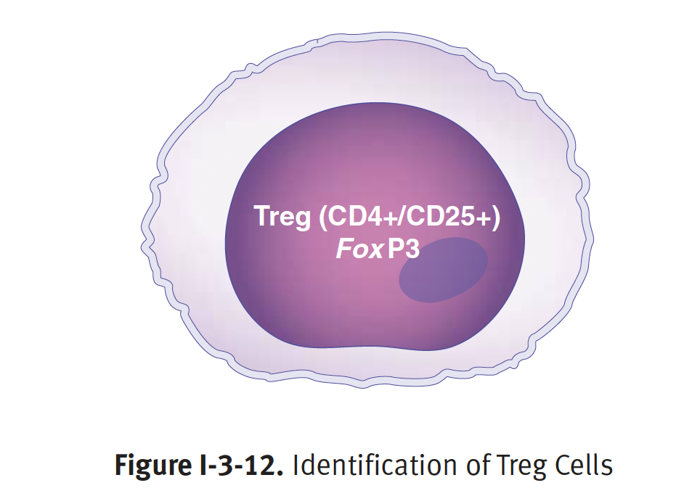
Regulatory T cells (T-regs)
Most self-reactive T cells will be deleted in the thymus, a small proportion of these T cells will instead differentiate into T-regs
T-regs inhibit self-reactive Th1 cells in the periphery
Identified by their constitutive expression of CD25 on the surface and expression of transcription factor FoxP3
Secrete IL-10 and TGF- 𝛃 which inhibit inflammation
Critical in the prevention of autoimmunity

Slide 16
Secondary Lymphoid Tissues: B and T lymphocytes

Slide 17
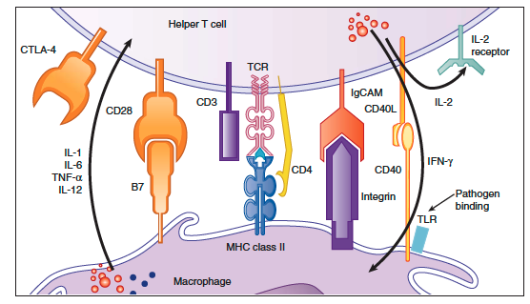
Activation of T lymphocytes
First (primary) signal: recognition of the MHC:peptide complex by the T cell receptor and coreceptors (CD4 and CD8)
Second (costimulatory) signal: recognition of B7 by CD28
Cytokines secreted by APCs and the activating T cells themselves induce the proliferation (clonal expansion) and differentiation of T cells into effector cells or memory cells
Notes:
- The adaptive immune response is initiated once antigen is processed and presented to a T cell. These interactions occur within the secondary lymphoid tissue.
- The purpose of these interactions is to generate effector cells, which will ultimately result in the elimination of the infection.
- In order to generate specific effector cells, the activation of T cells via the TCR must go through several checkpionts to ensure antigen specificity and eventual T-cell activation.

Slide 18
Development of Th1, Th2 and Th17 subsets
3 major classes of helper T (Th) cell arise from the same precursor, the naïve Th lymphocyte (Th0):
Th1
Th2
Th17
The pattern of differentiation is determined by the antigen or type of pathogen causing the infection, and the cytokines produced in response to the antigen, and the transcription factors stimulated by the cytokines
Notes:
Helper T lymphocytes serve as the orchestrators of virtually all the possible effector mechanisms that will arise to destroy the pathogen.
The effector mechanisms – include antibody synthesis, macrophage activation and CTL killing.

Slide 19
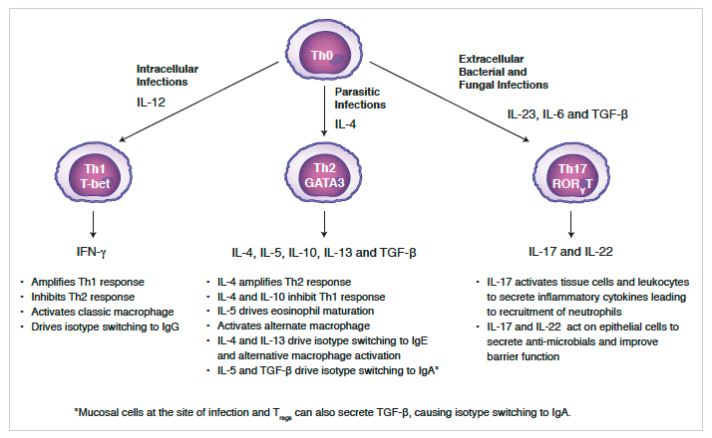
Notes:
Differentiation of a Th0 cell into a Th1 is stimulated by intracelluar pathogens (eg. Viruses and intracellular bacteria). These pathogens induce a strong innate immune response with the resultant production of IL-12 by macrophages and IFN-y by NK cells increasing the expression of the transcription factor T-bet. In turn, Th1 cells secrete high levels of the inflammatory cytokine IFN-y which ……..
Th0 differentiate into Th2 via constitutive production of IL-4 through the induction of transcription factor GATA-3 in response to large extracellular parasites eg. Helminths. Also IL-4 production from eosinophils and masts cells by helminths or allergens further drive Th0 differentiation to Th2.

Slide 20
Development of Cytotoxic T Lymphocytes
CD8+ T cells require both a primary and a costimulatory signal to become activated.
The main difference to CD4+ T cells, is that CD8+ T cells recognize their specific antigen presented by MHC class I molecules.
CD8+ T cells also rely upon cytokines produced by T helper cells to proliferate and ultimately differentiate into cytotoxic T lymphocytes (CTLs).

Slide 21
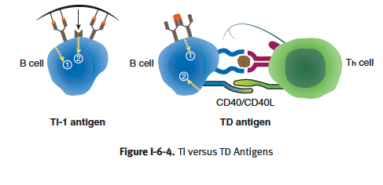
Activation of B lymphocytes
The antigens that B lymphocytes encounter are divided into 2 categories: thymus-independent (TI) antigens and thymus-dependent (TD) antigens
Notes:
As mature naïve B lymphocytes leave the bone marrow following successful reaarangement of their membrane immunoglobulin receptor genes, they recirculate in the blood, attracted to follicular areas of the lymph nodes and spleen.
If antigen entering these secondary lymphoid organs binds to and cross-links the idiotypes of the immunglobulin, this provides the first signal for activation of b lymphocytes

Slide 22
TI-Antigen Activated B Lymphocytes
Thymus-independent antigens are molecules (lipids, polysaccharides, lipopolysaccharides) that can activate B cells without having to interact with helper T cells.
The stimulate B cells to proliferate and differentiate into plasma cells
Secretion of IgM antibodies
Absence of immunologic memory
TI-antigens may also act a B-cell mitogens, directly causing mitosis regardless of the cell’s antigenic specificity
Notes:
- B cells activated by TI antigens are found in the spleen and mucosa

Slide 23
TD-Antigen Activated B Lymphocytes
B cell receptors crosslink with TD-antigen, processed them via exogenous pathway to generate MHC II:peptide complex
CD4+ T cells recognize the specific peptide on the MHC II and differentiate into T helper cells
Expression of CD40L on Th cell interact with CD40 on B cell to provide the signal for Activation
B lymphocytes activated by TD-antigens respond by proliferating and differentiating into plasma cells and memory B cells
Notes:
Response to TD-antigens require direct contact B cells with helper T cells and are influence by secreted cytokines

Slide 24
Humoral Immunity

Slide 25
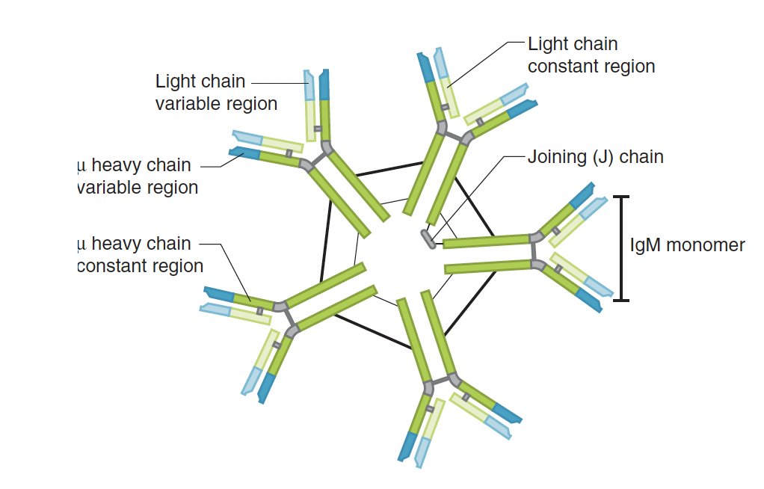
Humoral Immunity
The first isotype of immunoglobulin produce by B cell with or without T-cell help is IgM
IgM on the surface of B cell is a monomer, but secreted as a pentamer held together by J chain
The design makes it the most effective Ig isotype
Sponging free antigens
Activating complement
Possesses the highest avidity
Serum IgM cannot act as opsonin or a mediator of antibody-dependent cell-mediated cytotoxicity (ADCC)
Notes:
.This is because the coding for the constant domain of the heavy chain of IgM are the first sequences downstream from the coding of the idiotype of the molecule.
Avidity ( no. of binding sites available to bind epitopes)

Slide 26
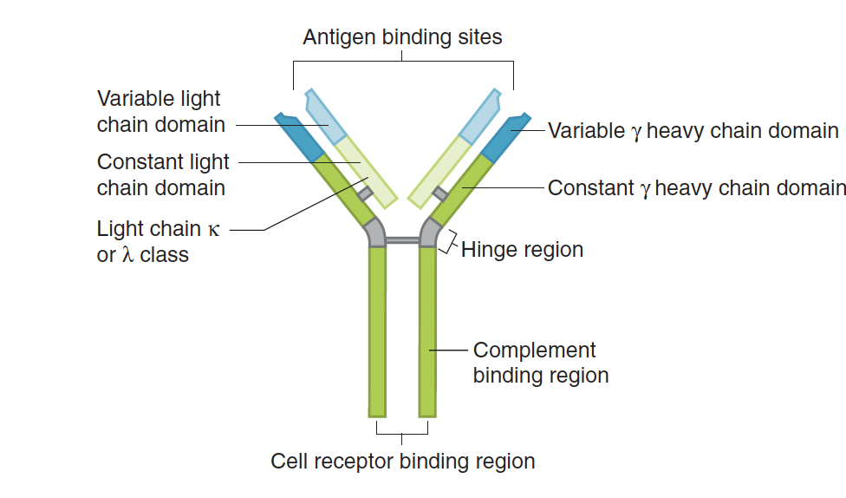
Class switching to IgG
IgG is produce after IgM during primary immune response
IgG is a monomeric molecule and produce in response to IFN-y
IgG has the following effector functions;
Activate complement
Acts as opsonin
Neutralizes pathogen and toxin
Mediates ADCC
IgG is also transported across placental for fetal protection

Slide 27
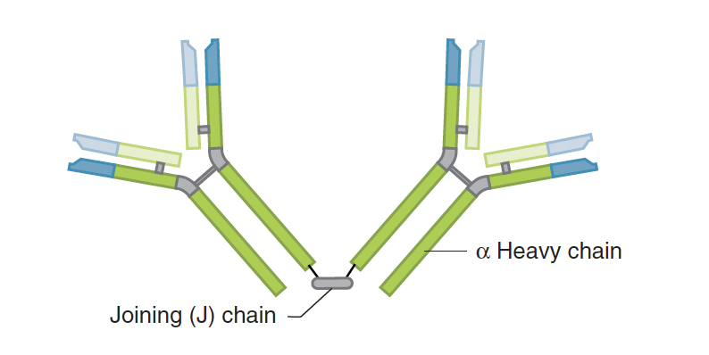
Class switching to IgA
IgA exist as dimer commonly produced in submucosa
Serves as the major proctective defense of mucosal surfaces
Induce by the production of TGF-𝛃 and IL-5 of infected cells
Does not activate complement, act as opsonin or mediate ADCC

Slide 28
Class switching to IgE
IgE binds to Fc receptors on mast cells, eosinophils and basophils.
It involved in protective immune responses against parasites and
allergen
It does not activate complement or act as opsonin

Slide 29
Cell-Mediated Immunity

Slide 30
Cell-Mediated Immunity
Cell-mediated immunity has evolved to battle 2 types of pathogens
Facultative intracellular pathogens
Obligate intracellular pathogens
Is dictated by Th1 response and is mediated primarily via macrophages and CD8+ T cells
The primary mechanism by which Th1 cells direct immunity is through cytokine secretion

Slide 31
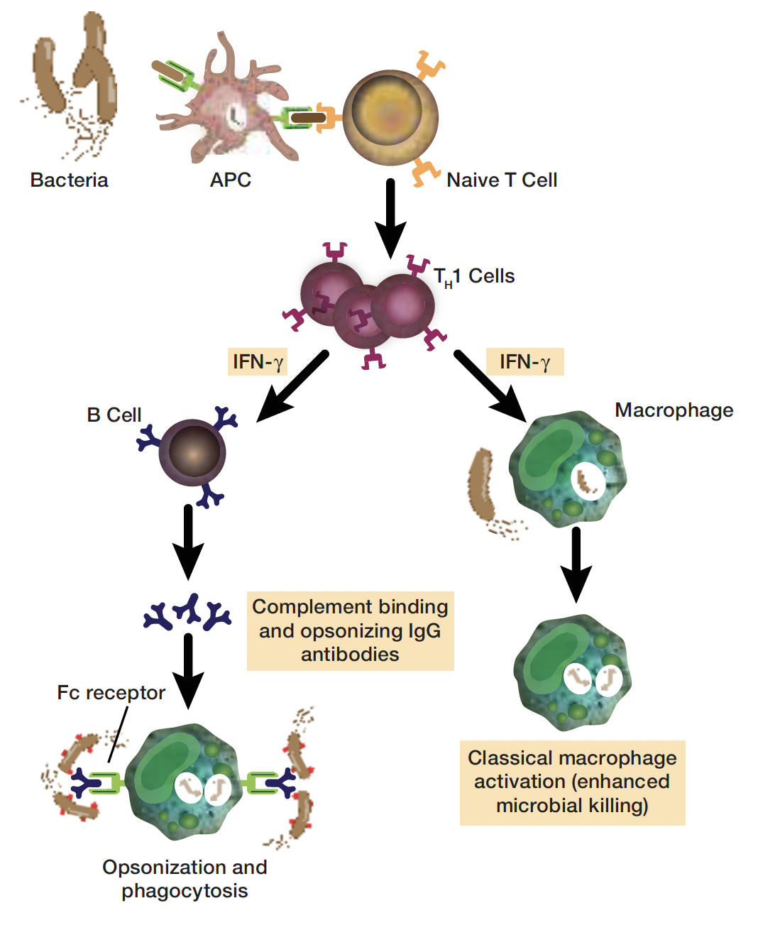
Macrophages/B cells
Th1 response activates both B cell and macrophages via cytokine IFN-y
IFN-y activates classical M1 macrophages to eradicate intracellular pathogens
IFN-y induces B cells to class switch to produce opsonizing IgG antibodies that assist macrophages with phagocytosis
Activated macrophages also produce Il-12 to activate Th cells
Notes:
- The reaction mediated by Th1 cell via macrophage and CD8+ T cell activation is often referred to as delayed-type hypersensitivity researction (DTH).

Slide 32
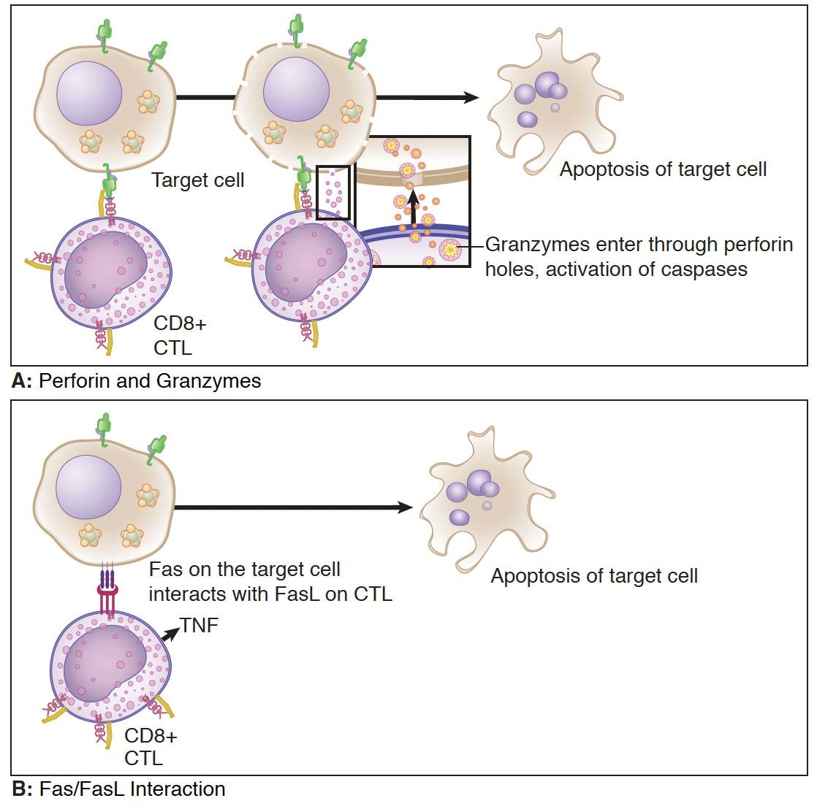
Cytotoxic T Lymphocytes (CTLs)
CTLs recognize the cell to kill by interaction between their TCR and the MHC class I peptide complex on the target cell surface.
CTLs kill their target cells by the delivery of toxin granule contents that induce apoptosis of the cell
Notes:
Death of target cell can be mediated in distinct fashion. First perforin in the CTL granules create pores in membrane of target cell through which granzymes enter, inducing activation of caspases, which activate the death domain.
Also activated CTL expressing Fas ligand (FasL) can bind Fas on target cell which induce caspases and death occur.
Another cell-mdeiated effector mechanism enhanced by Th1 cells is NK-cell killing.

Slide 33
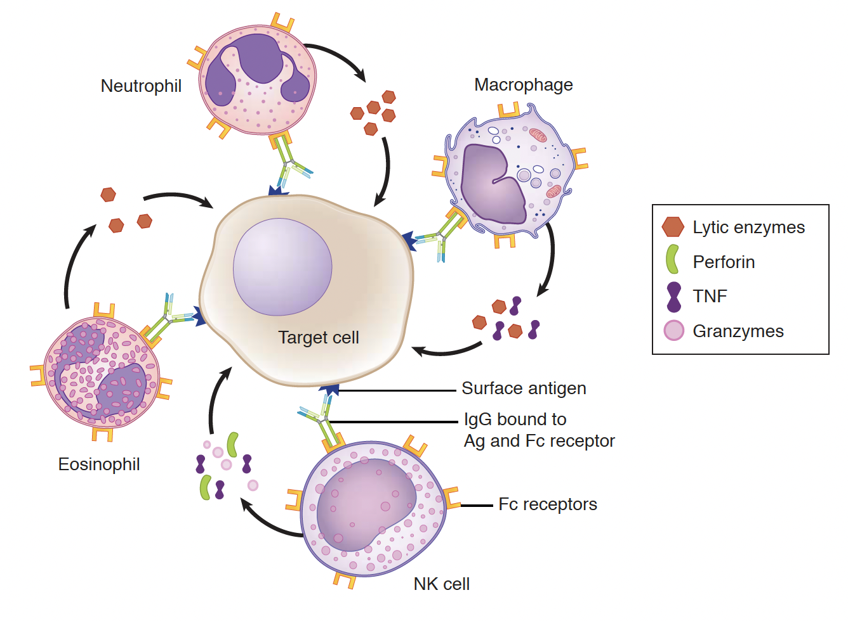
Antibody-dependent Cell-Mediated Cytotoxicity (ADCC)
ADCC bridges humoral and cell-mediated effector system
Cells with cytotoxic potential (NK cells, macrophages, neutrophils and eosinophils) have receptors for Fc region of IgG
When IgG bind to target cells, the cytotoxic cells bind to the Fc region of IgG causing lysis of the tarhet cell

Slide 34
Questions

